Slide 1
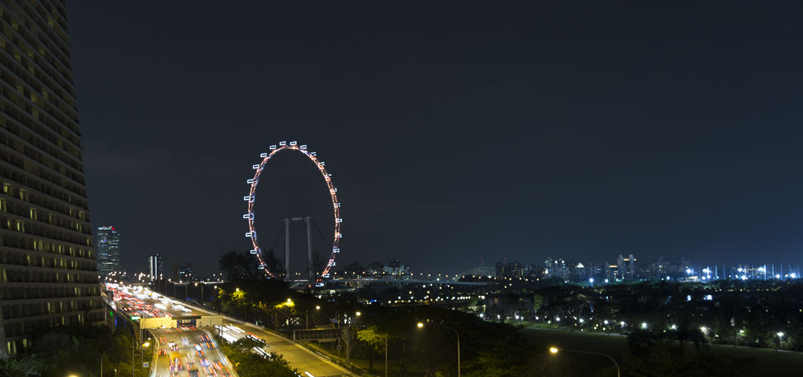





PowerShell Conference Asia

Slide 2
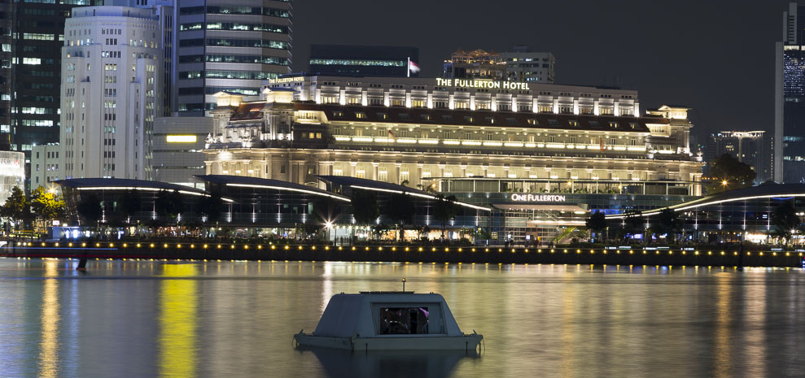
PowerShell Conference Asia

Slide 3

PowerShell Conference Asia

Slide 4
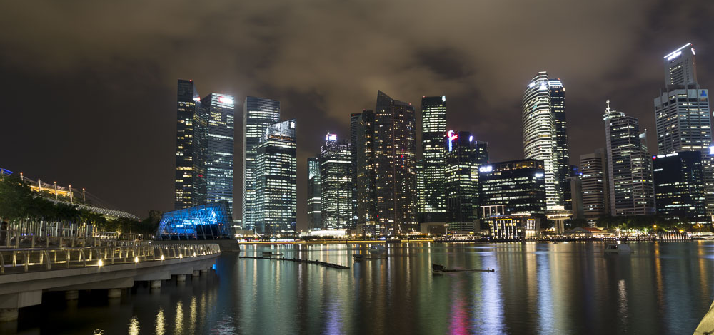
PowerShell Conference Asia

Slide 5
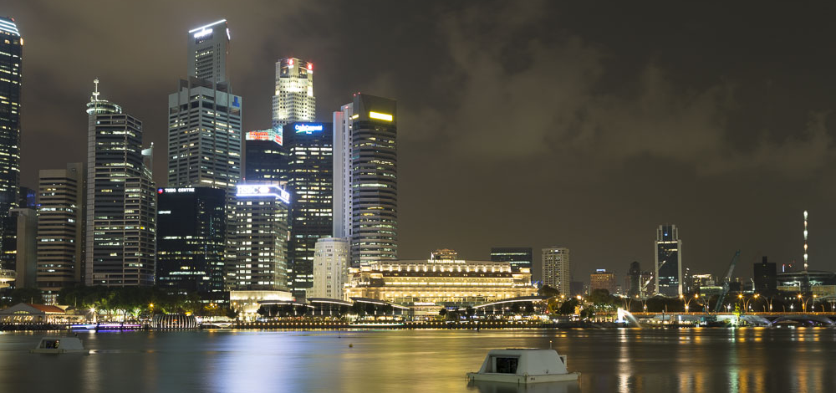
PowerShell Conference Asia

Slide 6
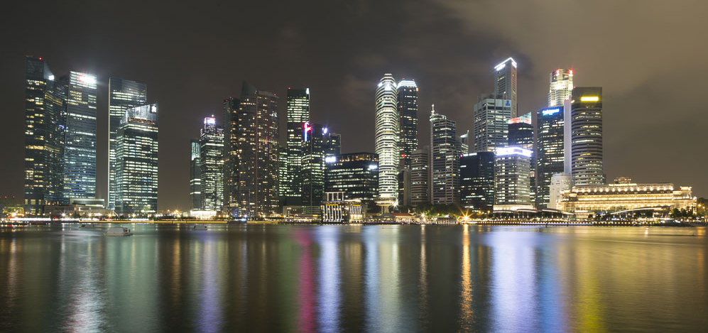
PowerShell Conference Asia

Slide 7
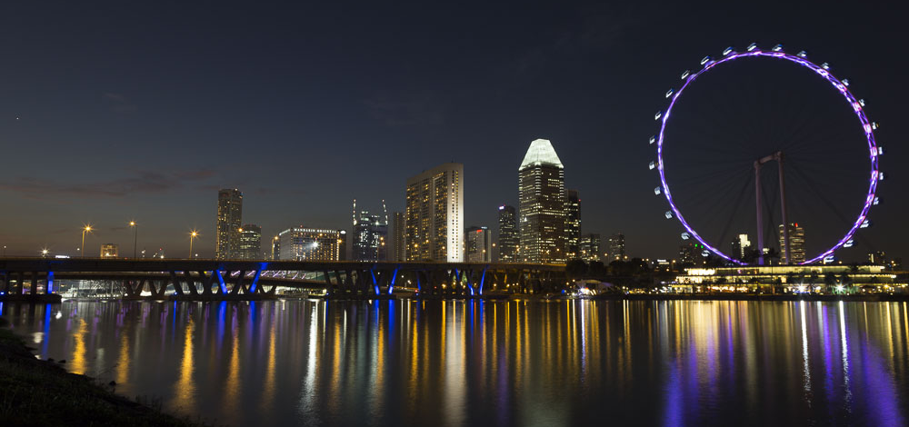
PowerShell Conference Asia
WHAT THE HECK IS MICROSOFT GRAPH AND WHY SHOULD I CARE
STEVEN HOSKING
@ONPREMCLOUDGUY

Slide 8
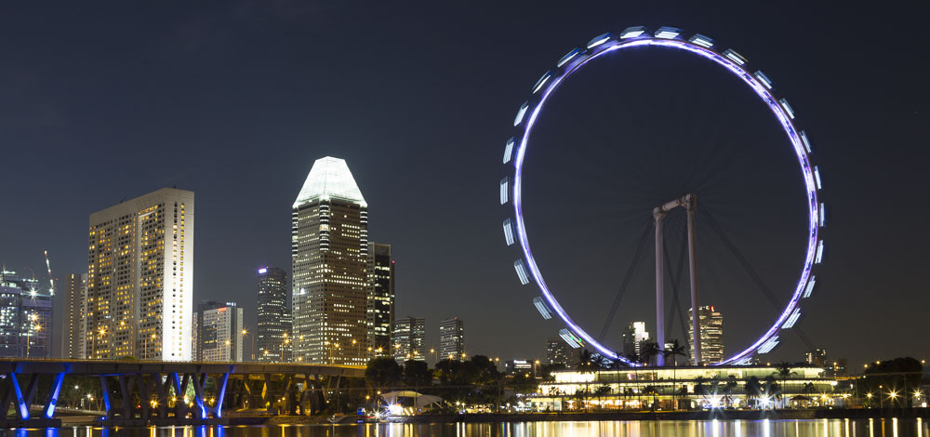
PowerShell Conference Asia

Slide 9
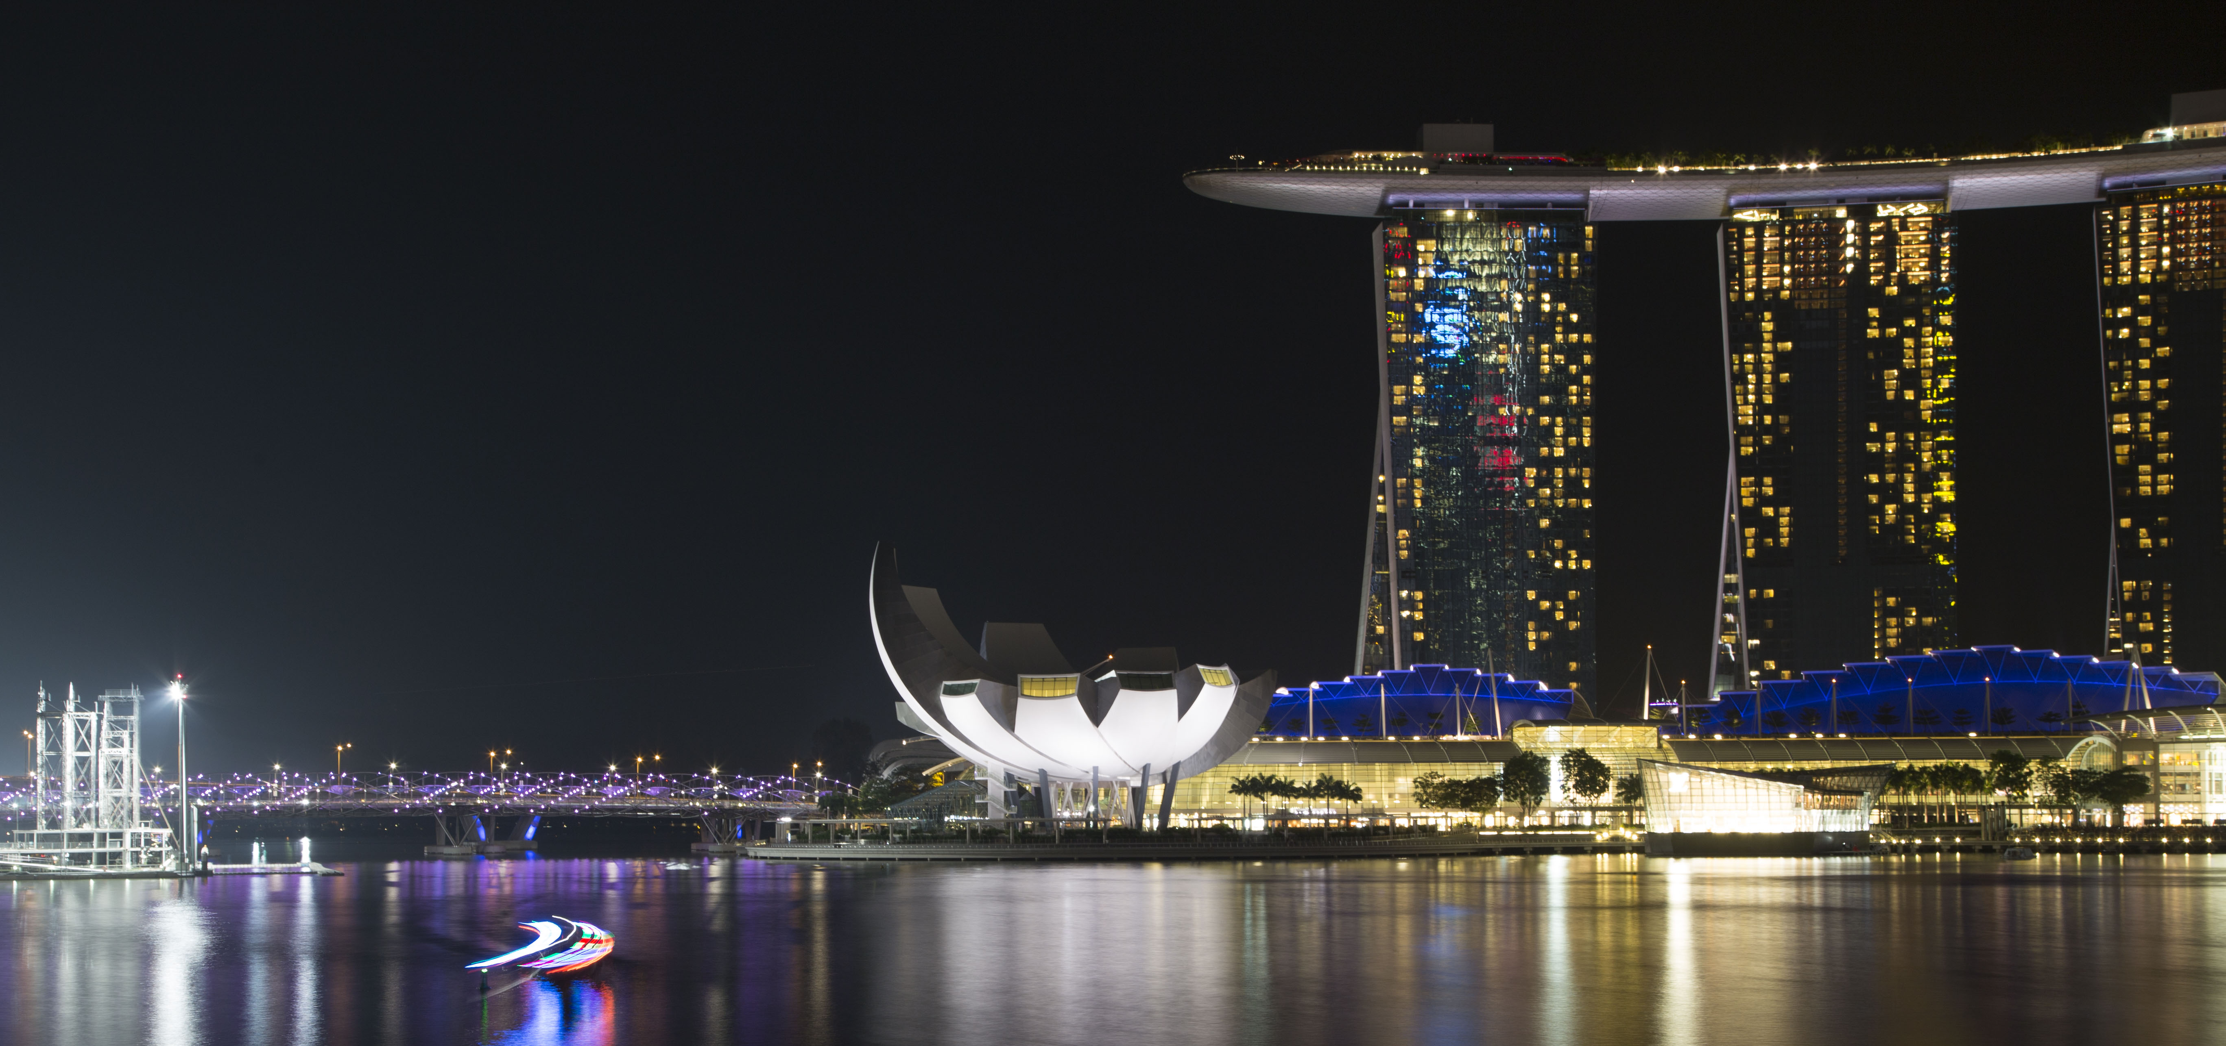
PowerShell Conference Asia

Slide 10
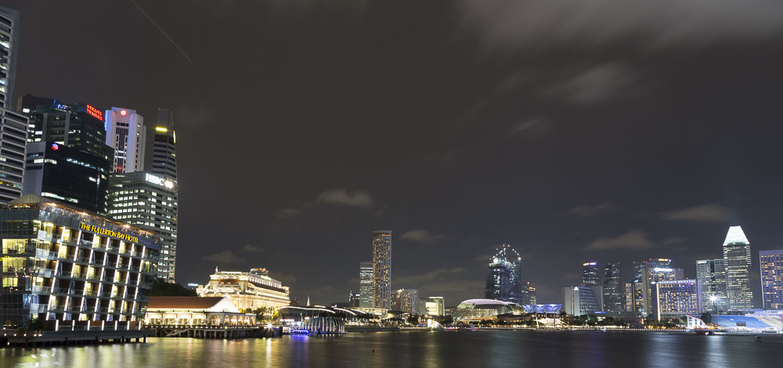
PowerShell Conference Asia

Slide 11
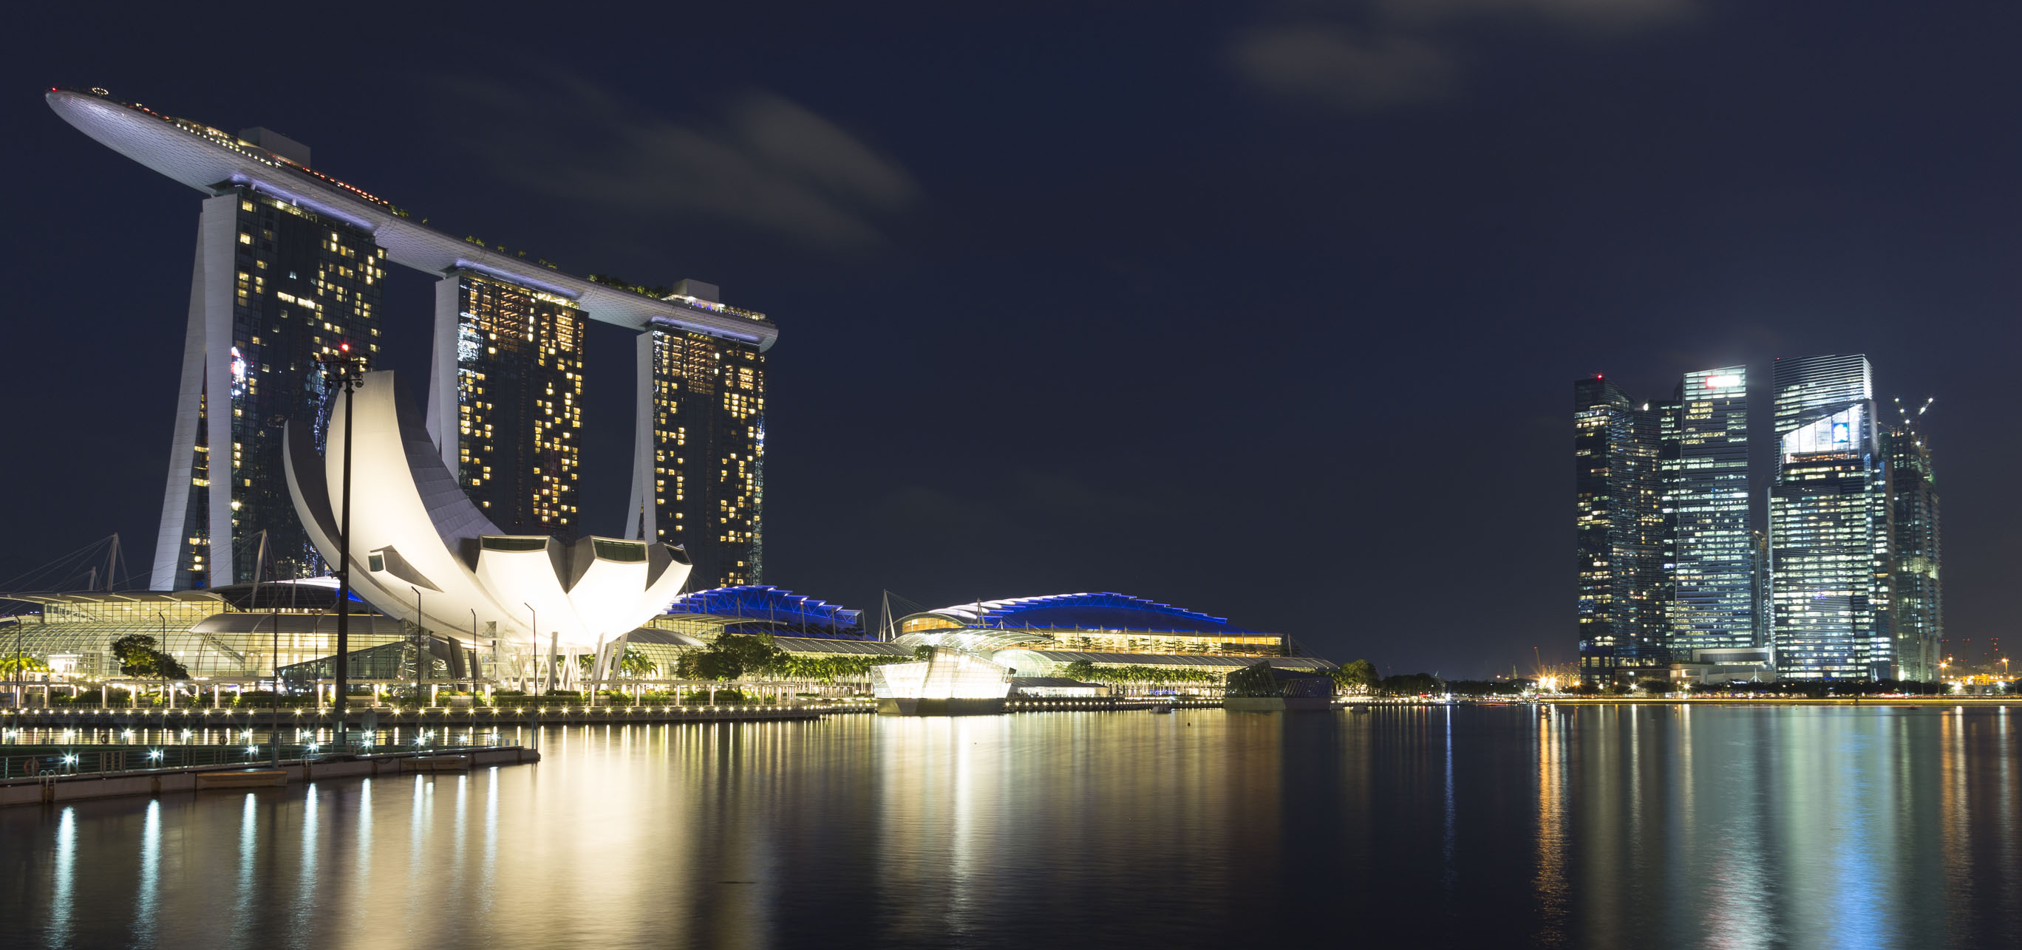
PowerShell Conference Asia

Slide 12
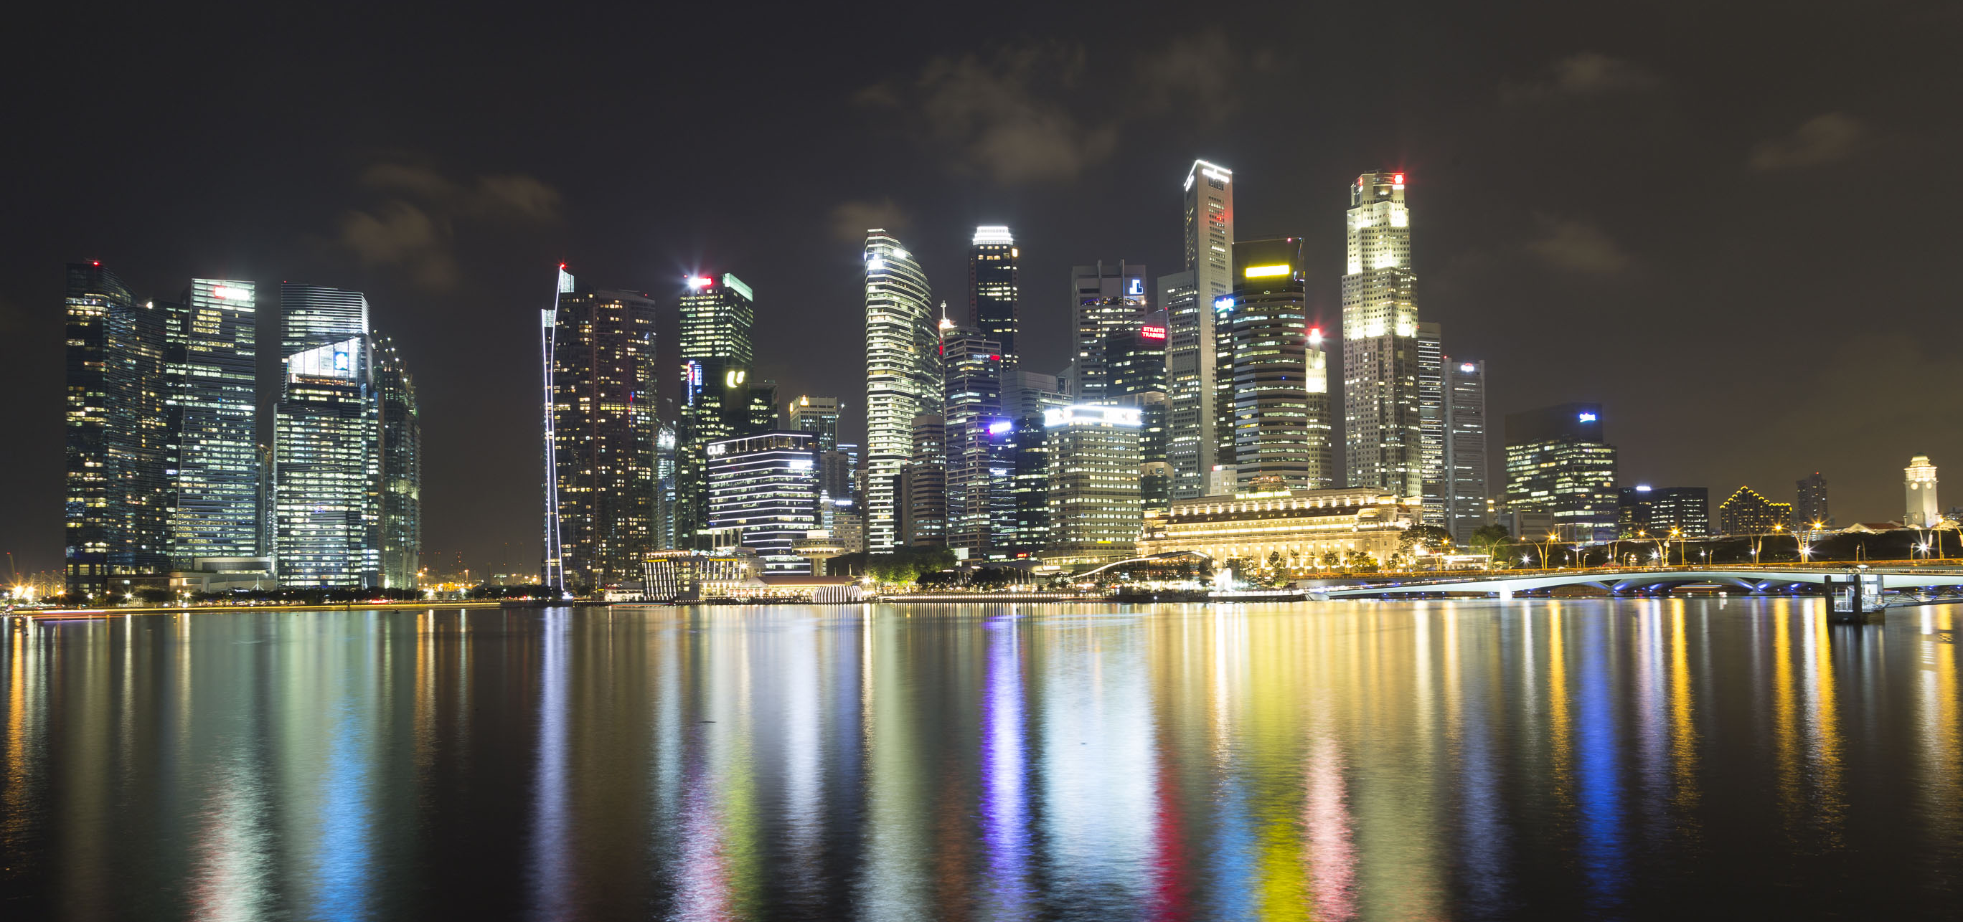
PowerShell Conference Asia

Slide 13

PowerShell Conference Asia

Slide 14





Who is Steve?
Steven Hosking
Senior Engineer
MVP – Enterprise Mobility
shosking@vigilant.it
@OnPremCloudGuy
PowerShell Conference
PowerShell Conference
Singapore 2017
Singapore 2017

Slide 15
Agenda
Existing management options
Products manageable by Microsoft Graph
Microsoft Graph
PowerShell Conference
PowerShell Conference
Singapore 2017
Singapore 2017

Slide 16
Existing Management Tools
Office 365
Web Portal
MSOnline – PowerShell etc.
Azure Active Directory
Web Portal
MSOnline
Azure AD PowerShell module
Intune
No API
Silverlight Portal (Internet Explorer only!)
PowerShell Conference
PowerShell Conference
Singapore 2017
Singapore 2017

Slide 17









Microsoft Graph
trendingAround
Shared with me
CONVERSATIONS
manager
USER
workingWith
registeredOwner
DEVICES
EVENTS
modifiedBy
TASKS
memberOf
workingWith
TASKS
GROUPS
createdBy
NOTES
PowerShell Conference
MESSAGES
NOTES
Singapore 2017
FILES

Slide 18

Data
Microsoft Graph
https://graph.microsoft.com/
Users
Groups
Files
Mail
Calendar
Personal Contacts
Notes
Tasks
Org Contacts
People
Excel
Notes
Insights and relationships
Authentication and Authorization
OpenID Connect and OAuth 2.0
Development Environment
XCode
Eclipse or Android Studio
Visual Studio
REST
Solution
YOUR APP
Your choice of technology (.NET, JS, HTML, Ruby, etc.)
Microsoft Azure
Other hosting (IIS, LAMP, etc.)
PowerShell Conference
Singapore 2017

Slide 19

Microsoft Graph – Relationships
Microsoft Graph can show the relationships that it has with different resources
GET: https://graph.microsoft.com/v1.0/me
{
"displayName": "Tenant Admin Account",
"preferredLanguage": "en-US",
"userPrincipalName": admin@graphdemo.onmicrosoft.com
}
GET: https://graph.microsoft.com/v1.0/me/memberOf
{
"@odata.type": "#microsoft.graph.group",
"id": "ee0af6a3-db7c-47dd-ac77-b74e2a1b8676",
"displayName": "All Users"
}
GET: https://graph.microsoft.com/v1.0/me/ownedDevices
{
"value" : […]
}
GET: https://graph.microsoft.com/v1.0/me/assignedLicenses
{
"disabledPlans": [],
"skuId": "9bc22083-45c4-4d60-93f1-39a540ac7649“
}
Devices
Groups
me
ownedDevices
memberOf
assignedLicenses
Licenses
PowerShell Conference
Singapore 2017

Slide 20
Microsoft Graph – Query Format
Graph URL
(Static)
Version
(v1.0 or Beta)
Specific entity type / resource, such as users, groups, devices, etc.
https://graph.microsoft.com/v1.0/users?$filter=userPrincipalName eq 'bob@tenant.onmicrosoft.com'
Optional Odata query arguments: $filter, $top
PowerShell Conference
Singapore 2017

Slide 21












SDKs, samples and tooling
GA*
GA
GA
GA
PREVIEW
ASP.NET MVC
JavaScript
Angular
PHP
Python
GA*
GA*
GA*
PREVIEW
PREVIEW
Xamarin
UWP
Android
iOS
Ruby
UPDATED
PREVIEW
PowerShell Conference
VS integration
Bindings
Singapore 2017

Slide 22
Demo
PowerShell Conference
Singapore 2017

Slide 23
Where can you find more Information
Microsoft Graph Website
https://graph.microsoft.com
Graph Explorer
https://developer.microsoft.com/en-us/graph/graph-explorer
Graph Documentation
https://developer.microsoft.com/en-us/graph/docs/concepts/overview
Graph Samples
https://github.com/microsoftgraph
https://github.com/microsoftgraph/powershell-intune-samples
PowerShell Conference
Singapore 2017

Slide 24
PowerShell Conference
Singapore 2017

Slide 25
Don’t Forget!
Fill in your survey in Mobile app – it’s how we do better!
Don’t lose you badge! You need it for the Social Events
Grab the Speakers for a chat – they all have time for you!
Let everyone know what they are missing on Social Media
#PowerShell
#PSConfAsia
Photos of Marina Bay Credit: Sebastian Szumigalski
PowerShell Conference
Singapore 2017

